Slide 1

Memory Design and Testing (PVL 331)
Dr. Rajneesh Sharma
Assistant Professor
Thapar Institute of Engineering & Technology, Patiala

Slide 2
Module 1
Basics of Semiconductor Memory
Internal Organization of Memory Chips
SRAM Cell
DRAM Cell
Ferroelectric Memory
Flash Memory Cell

Slide 3
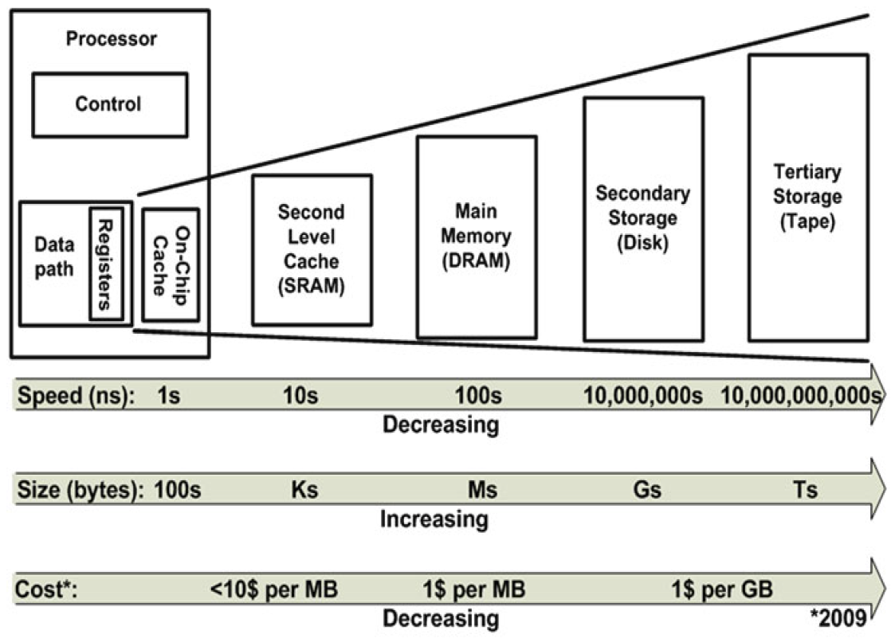
SRAM (Static RAM)
Notes:
Before start discussion on SRAM let me tell about Memory hierarchy of a modern computer system. The memory hierarchy ranges from high-performance, small sized but expensive on-chip memories to slower, large sized but affordable off-chip memories such as optical or magnetic memories, DRAM. The processor tries to keep repeatedly used data and instructions closer to itself, i.e. in the faster on-chip memory, which is referred as “cache” memory, to meet the requirements of high performance systems. The on-chip cache memories are generally called L1, L2 and even L3. The different levels of cache memories are static random access memories (SRAMs) and they dominate the memory hierarchy in performance but they are often integrated in a lesser capacity due to area limitations and the high cost per bit.

Slide 4
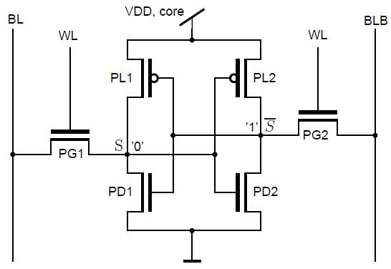
SRAM (Static RAM)
The transistors are named pull-up (PL1, PL2), pull-down (PD1, PD2) and access (PG1,PG2).
Word-line (WL), serve as switches between the inverter pair and the complementary pair of bit-lines or data-lines (BL, BLB).
It is assumed that the internal data storage nodes S and SB are at ‘0’ and ‘1’, respectively.
SB
Fig. 8 CMOS standard six-transistor (6T) SRAM bitcell.
Notes:
Although many SRAM core cell designs exist with different number of transistors, the standard choice is the cell with six transistors, called the 6T SRAM cell. This section gives you a brief overview of the standard 6T SRAM bit-cell and its design issues. Figure 8 shows the core 6T SRAM cell consisting of two cross-coupled inverters and therefore the two memory nodes which keep the one-bit of information, either ‘1’ or ‘0’. The internal nodes S and SB of the 6T SRAM always contain complementary values. In CMOS technology, the cross-coupled inverter pair consists of two PMOS pull-up (PU) devices PL1 and PL2 and two NMOS pull-down (PD) devices PD1, PD2. Two additional NMOS access-transistors (pass-transistors) PG1 and PG2 are required to read and write the cell in a differential way. The pass transistors PG1, Pg2 serves as switch between complementary pair of storage nodes (S and SB) and bit-lines or data-lines (BL and BLB), which are controlled by the word-line (WL). The complementary BL and BLB are used to read or write the data on S and SB nodes.

Slide 5
SRAM
There are three operations in 6T SRAM cell.
Hold: The access transistors are disabled (WL=0), the information is stored on the feedback-coupled inverter-pair.
Read (0): Both bit-lines BL and BLB are pre-charged to V_{DD}, then the access transistors are enabled (WL=1). The S (0) node provides a conducting path to ground through PD1 and discharge the BL via PD1 .
For Read stability,
S must not flip i.e. PD1 >> PG1
OFF
ON
SB
ON
OFF
Fig. 8 CMOS standard six-transistor (6T) SRAM bitcell.
Notes:
The three standard operations, Hold, Read and Write, are performed in 6T SRAM cell in the following ways: Consider that the initial values of internal nodes S and SB are “0” and “1”, respectively.
In hold operation we don’t need the data to be write or read from the nodes. So The access transistors are disabled i.e. WL=0. the information remain stored as long as vDD is ON.
Next is Read Operation: Now nodes S and SB needed to be read So both BL and BLB are pre-charged to Vdd. After that PG1 and PG2 transistors are enabled using WL. In this way S node provide conducting path for bitline BL to ground and BL discharge. On the other hand, BLB do not discharge as PD2 remain OFF. A sense amplifier detects the decreasing voltage on one of both bit-lines and treat discharging side as ’0’ memory node and non-discharging side as 1. The sense-amplifier serves to speed-up the read process, because the bit-line then does not need to be discharged completely down to 0 V.

Slide 6
SRAM
There are three operations in 6T SRAM cell.
Hold: The access transistors are disabled (WL=0), the information is stored on the feedback-coupled inverter-pair.
Read (0): Both bit-lines BL and BLB are pre-charged to V_{DD}, then the access transistors are enabled (WL=1). The S (0) node provides a conducting path to ground through PD1 and discharge the BL via PD1 .
For Read stability,
S must not flip i.e. PD1 >> PG1
OFF
ON
SB
ON
OFF
SB
BLB
WL
BL
S
Notes:
In the read operation S node must not flip in order to have stable read operation. In other words, we can say that s node should not flip other inverter. This would be possible PD1 is made stronger than pass transistor. In this way S node immediately transfer the charge of BL line to ground. PD1 stronger means width of PD1 should be higher than the width of PG1.
In the timing diagram you can observe read operation more closely. Initially BL and BLB both are precharged. As soon as WL is high BL start to discharge at the same time S node charge up (this charging of S node should not flip the inverter2).

Slide 7
SRAM
There are three operations in 6T SRAM cell.
Write (0 to 1): For write “1” operation (BL=1, BLB=0, WL=1), BL charge the node S through PG1 above the V_{TH} of PL2 and flip the nodes.
For writability,
PG1 must overpower the feedback inverter i.e. PG1 >> PL2
OFF
ON
SB
ON
OFF
SB
S
BLB
Fig. 8 CMOS standard six-transistor (6T) SRAM bitcell.
WL

Slide 8
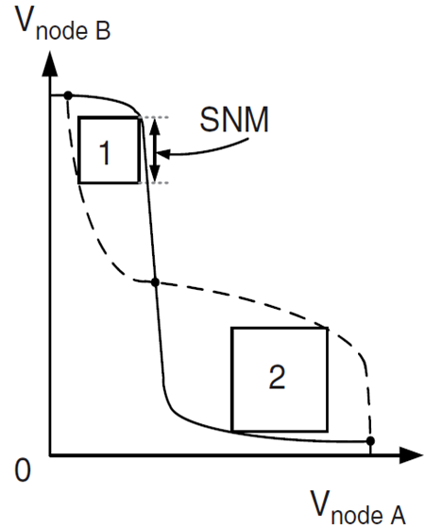
SRAM
High bitlines must not overpower inverters during reads. But low bitlines must write new value into cell.
Read and Write operations have contrary requirements for pass transistors. So the width of transistors need to be selected carefully.
. PD1 >> PG1 (For Read stability)
PG1 >> PL2 (For writ ability)
Read and write Noise Margins (NM) used assess the performance of SRAM cell. These NMs measured through butterfly curve.
Solid: V_{OUT1}
Dotted: V_{IN2}
Solid: V_{IN1}
Dotted: V_{OUT2}
Notes:
Solid line in curve represents VTC of invert1 and dotted represents VTC of inverter 2. Minimum of box 1 and 2 decide the noise margin. E.g. here box is lower than 2 so 1 is the SNM for SRAM.
If the inverters are identical, the DC transfer curves are mirrored across the line of V1 = V2. The butterfly plot shows two stable states (with one output low and the other high) and one metastable state (with V1 = V2). Two square has been fit into the two wings. Smaller square box gives us the SNM value. A positive value of noise shifts curve I left and curve II up. This can be seen in the figure.
Successful data retention during read and hold operations are determined by read SNM and read hold SNM, respectively. The write trip voltage parameter is used to measure how easily data can be flipped in storage nodes. These three SRAM performance metrics are extensively utilized for performance analysis and design of 1-bit SRAM cell.

Slide 9
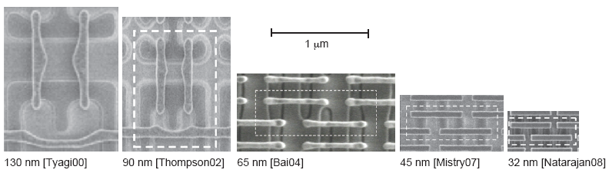
SRAM
Five generations of Intel SRAM cell micrographs
Transition to thin cell at 65 nm
Steady scaling of cell area
Fig. 9 Trends in commercial SRAM cells
Notes:
Figure shows how SRAM cell size has scaled over five process generations. The micrographs show the diffusion and polysilicon regions. Observe the transition from the traditional cell to the thin cell.
The cell size has scaled well despite the growing challenges of lithography and variability. SRAM is so important that design rules are scrutinized and bent where possible to minimize cell area in commercial processes. Here, The substrate and well contacts are shared among multiple cells to save area at the expense of regularity.

